Slide 1
PROJECT PRESENTATION
PROJECT TITLE – COZY HAVEN
PROJECT DONE BY – RAMYA R
TRAINER NAME – JAVEED MOHAMMED HUSNUDDIN

Slide 2
DESCRIPTION
In my project there are 3 main modules – User,Hotelowner,Admin.
This Project was mainly focused to give services for User to book their comfort Rooms and he/she can check their reservation history and also he/she can cancel their bookings and request for refund by submitting the reason for refund.
Hotelowner can manage refund request he/she can approve or reject refund request and also he/she can add new rooms,edit existing rooms and can delete existing rooms.
Admin can manage users by searching a user by UserId and can view all users and similarly he/she can search owner and can view all available owners and he can view all the reservations done by users and he/she is responsible for adding new hotel,and can edit and delete existing hotels.

Slide 3
TECHNOLOGIES USED
For Backend part I have used technologies like Core Java,Spring Boot, Spring Data JPA,Spring Security,Spring web
For Frontend part I have used technologies like HTML,CSS,Typescript,Angular, Bootstrap
For DataBase part I have used MySQL.
For Testing I have done Unit Testing for Backend and used tools like Postman and Swagger.
For deployment of my project I have used Docker

Slide 4
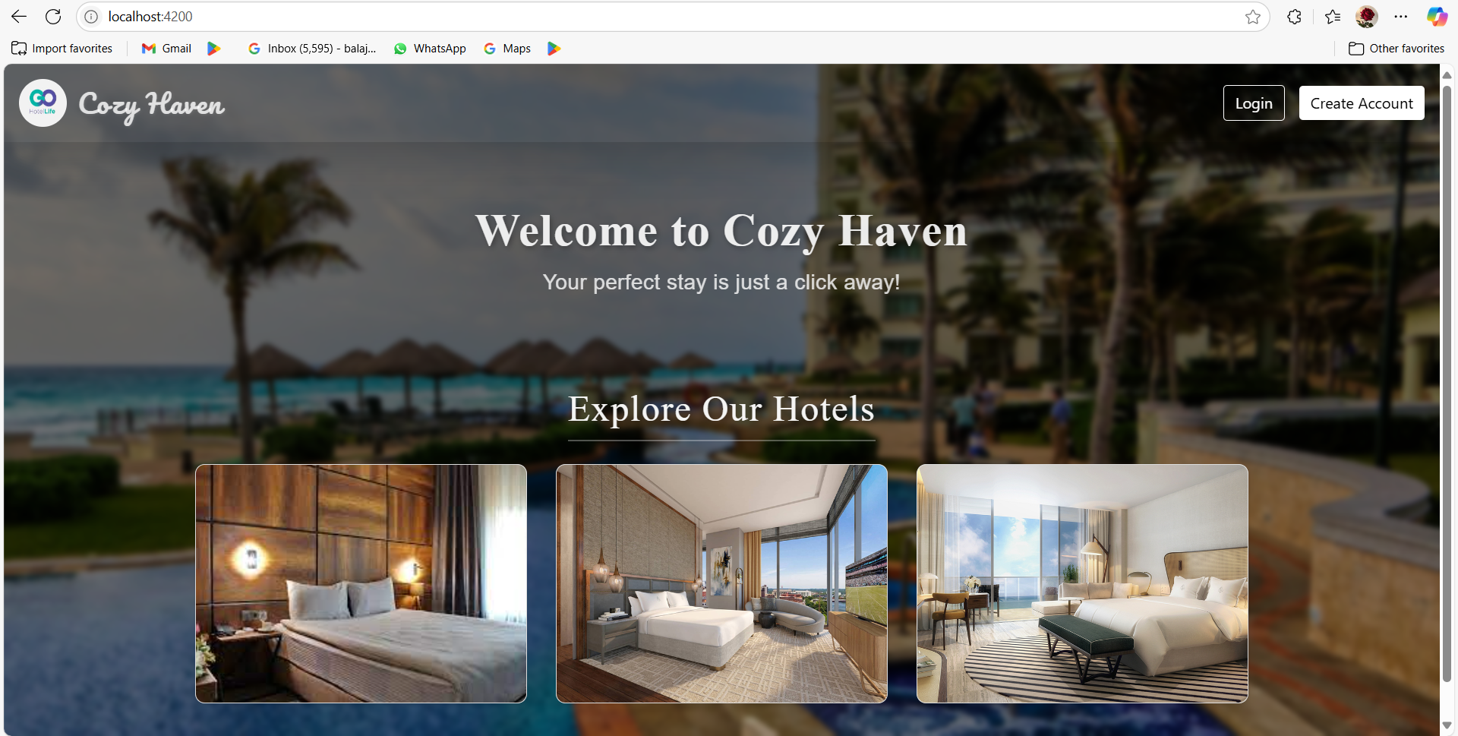
OUTPUT SCREENSHOTS

Slide 5
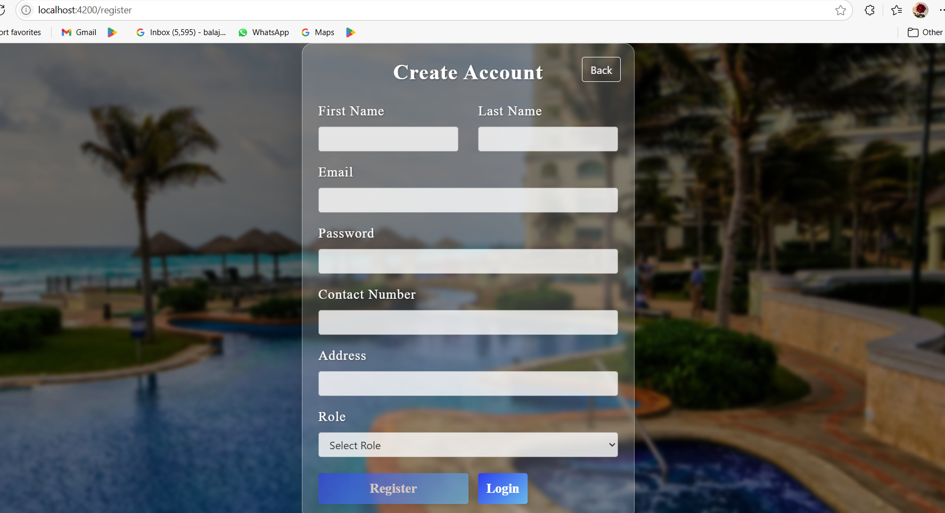

Slide 6
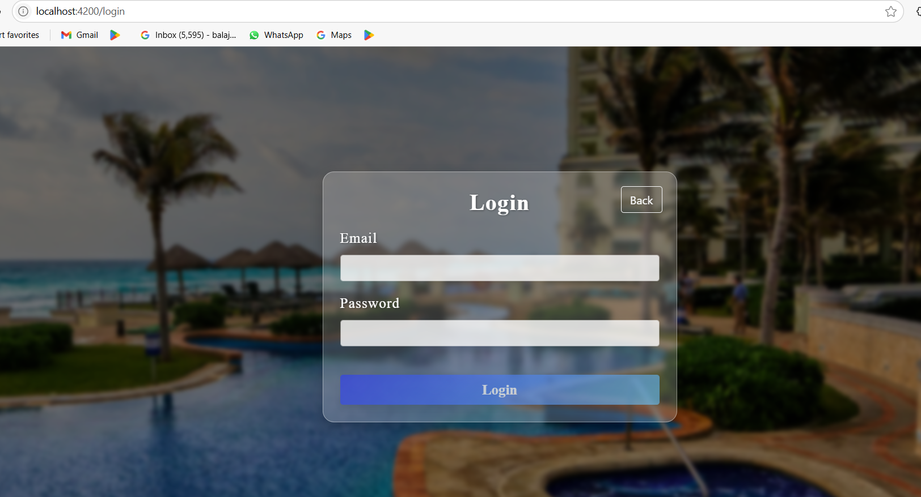

Slide 7
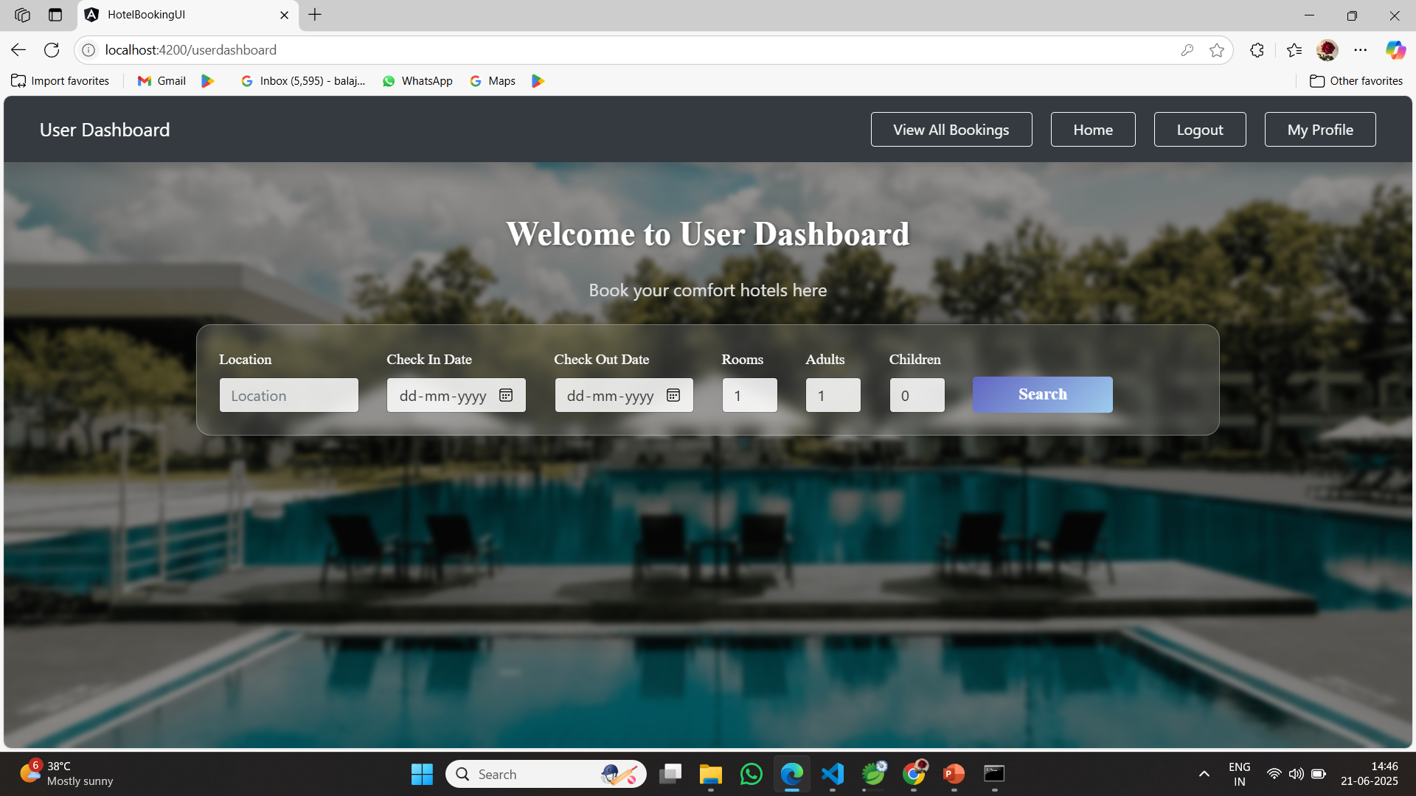

Slide 8
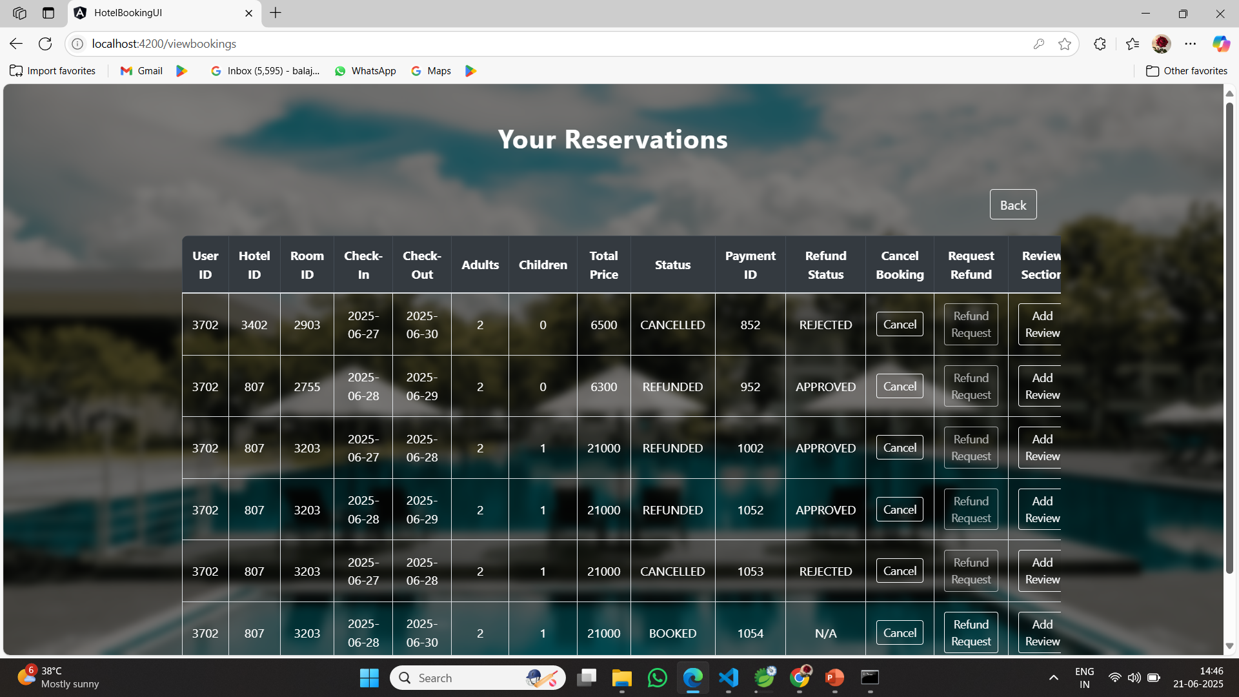

Slide 9
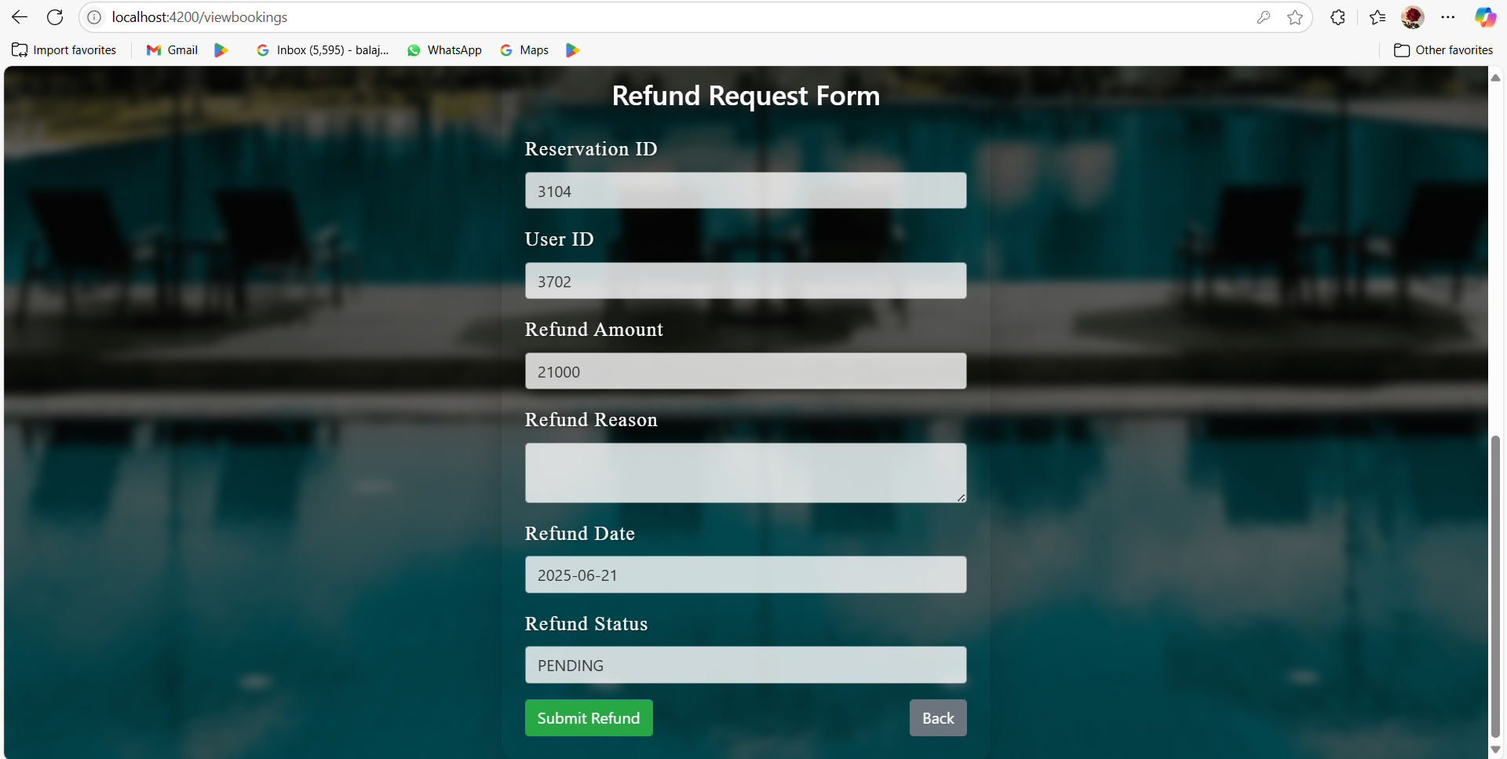

Slide 10
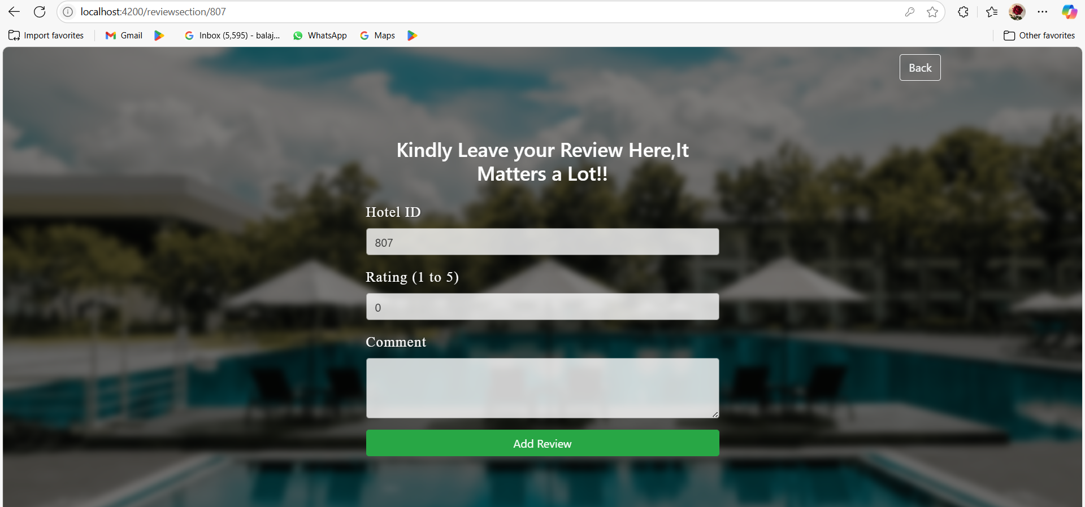

Slide 11
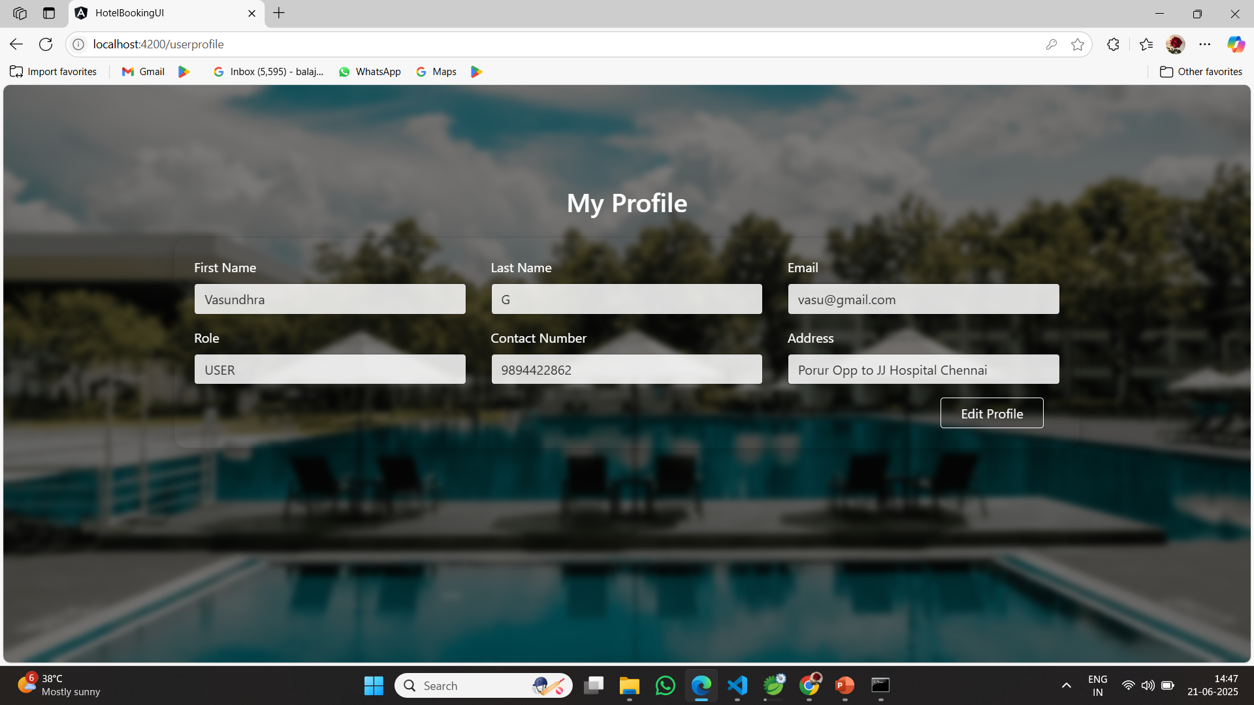

Slide 12
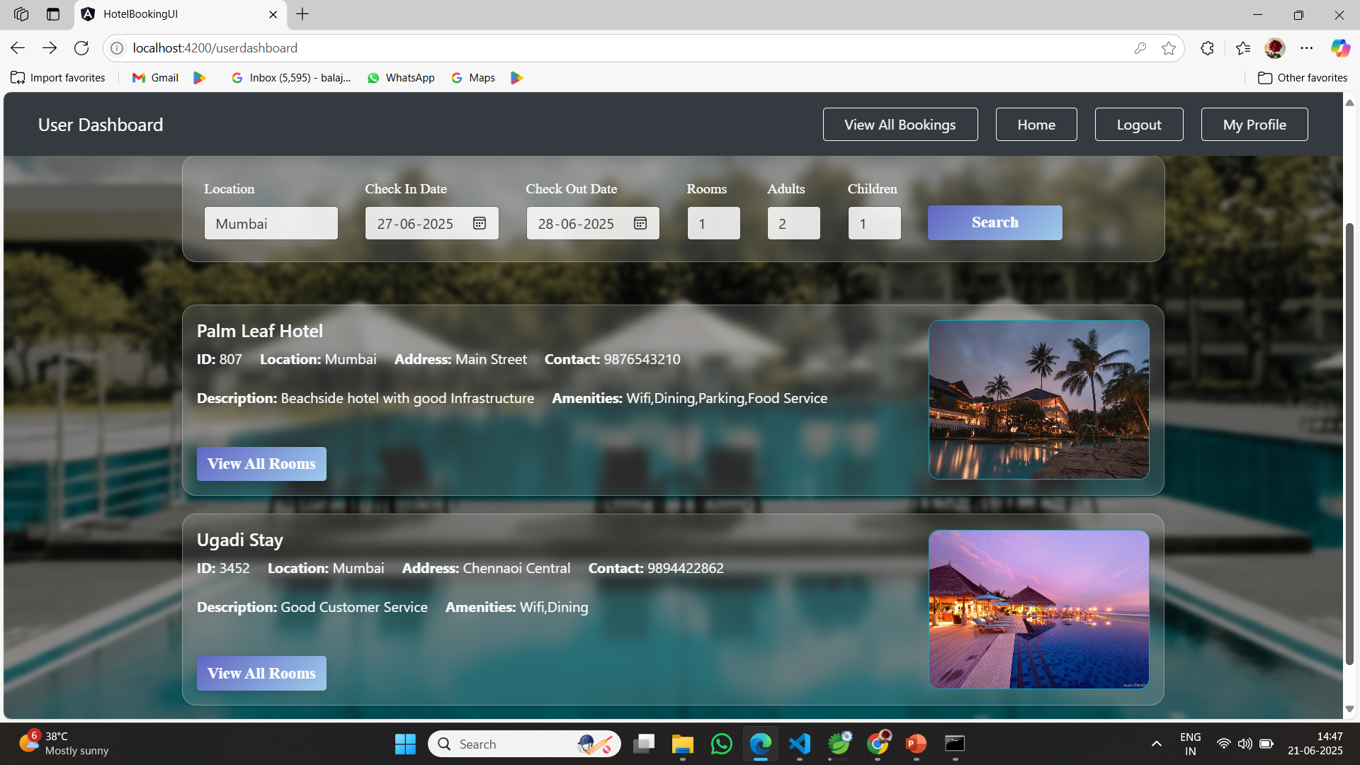

Slide 13
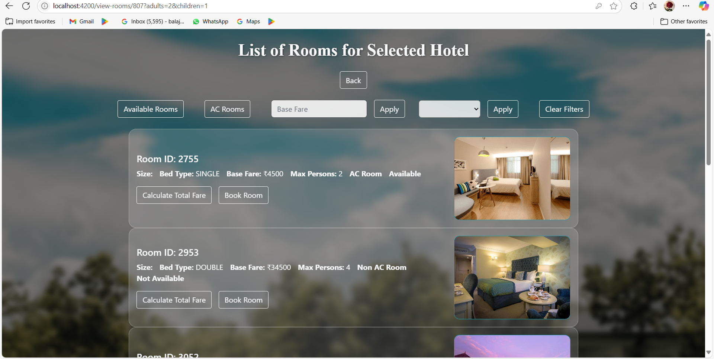

Slide 14
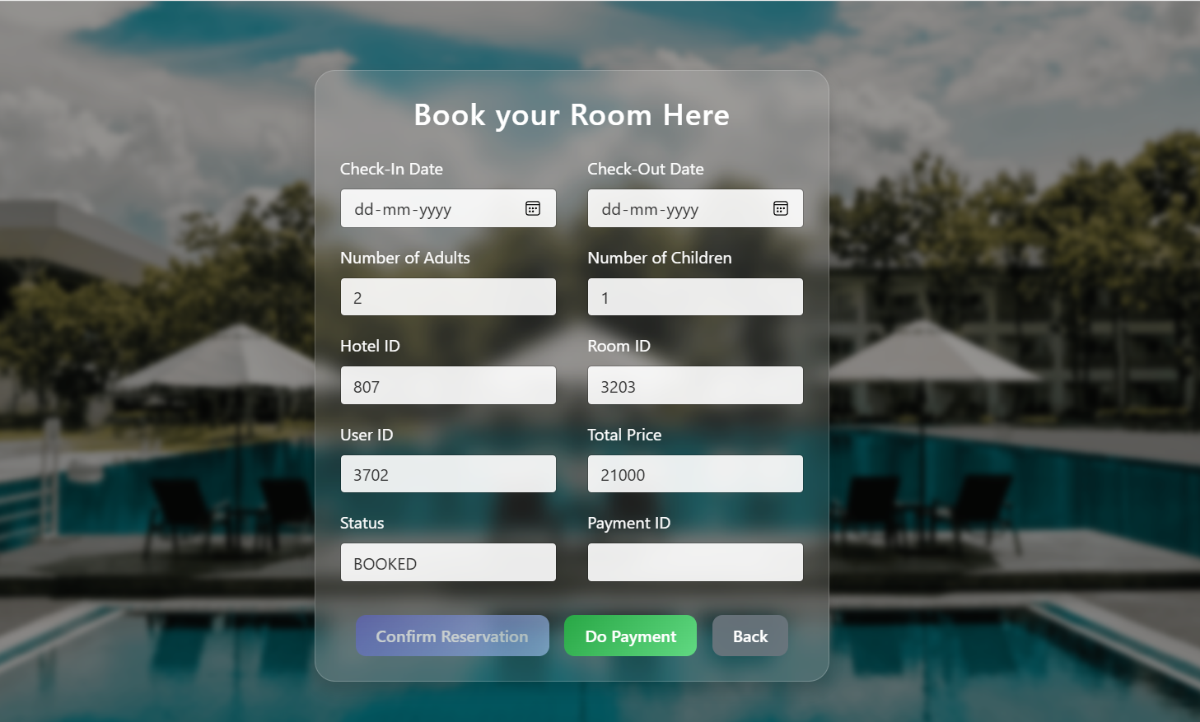

Slide 15
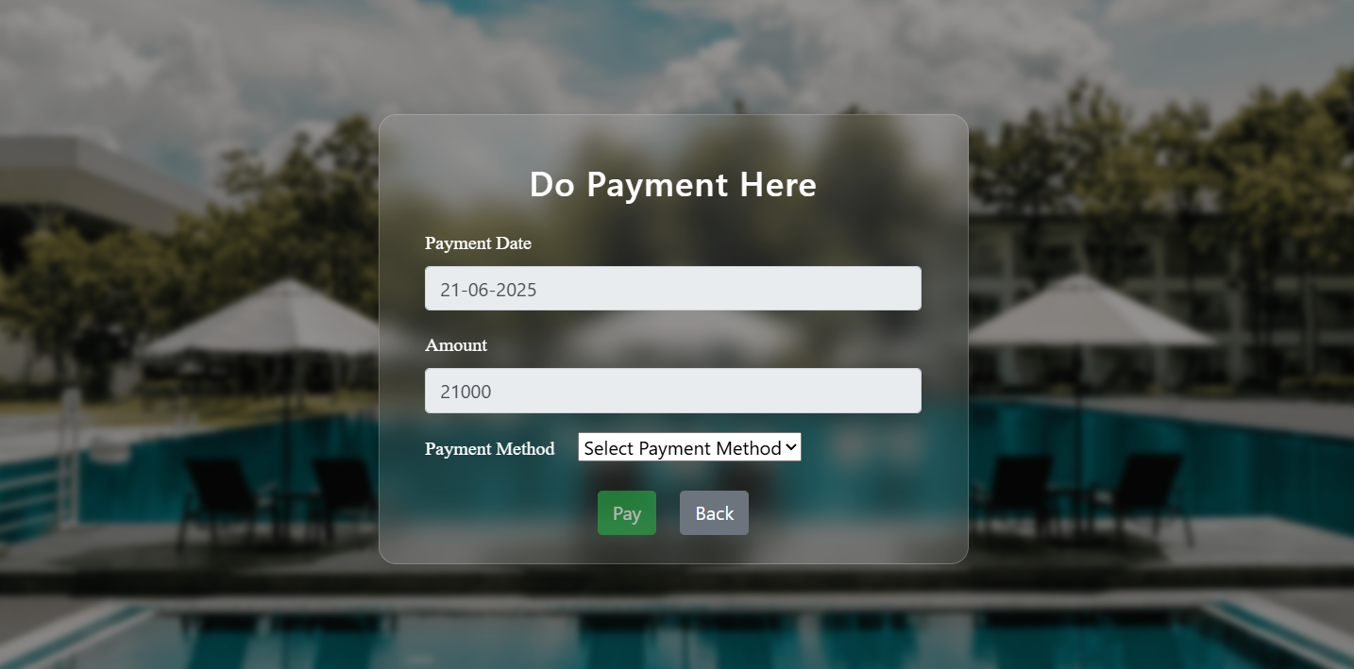

Slide 16
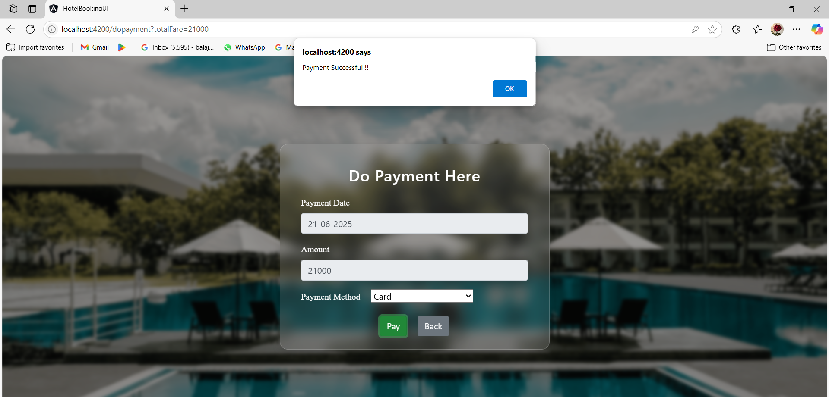

Slide 17
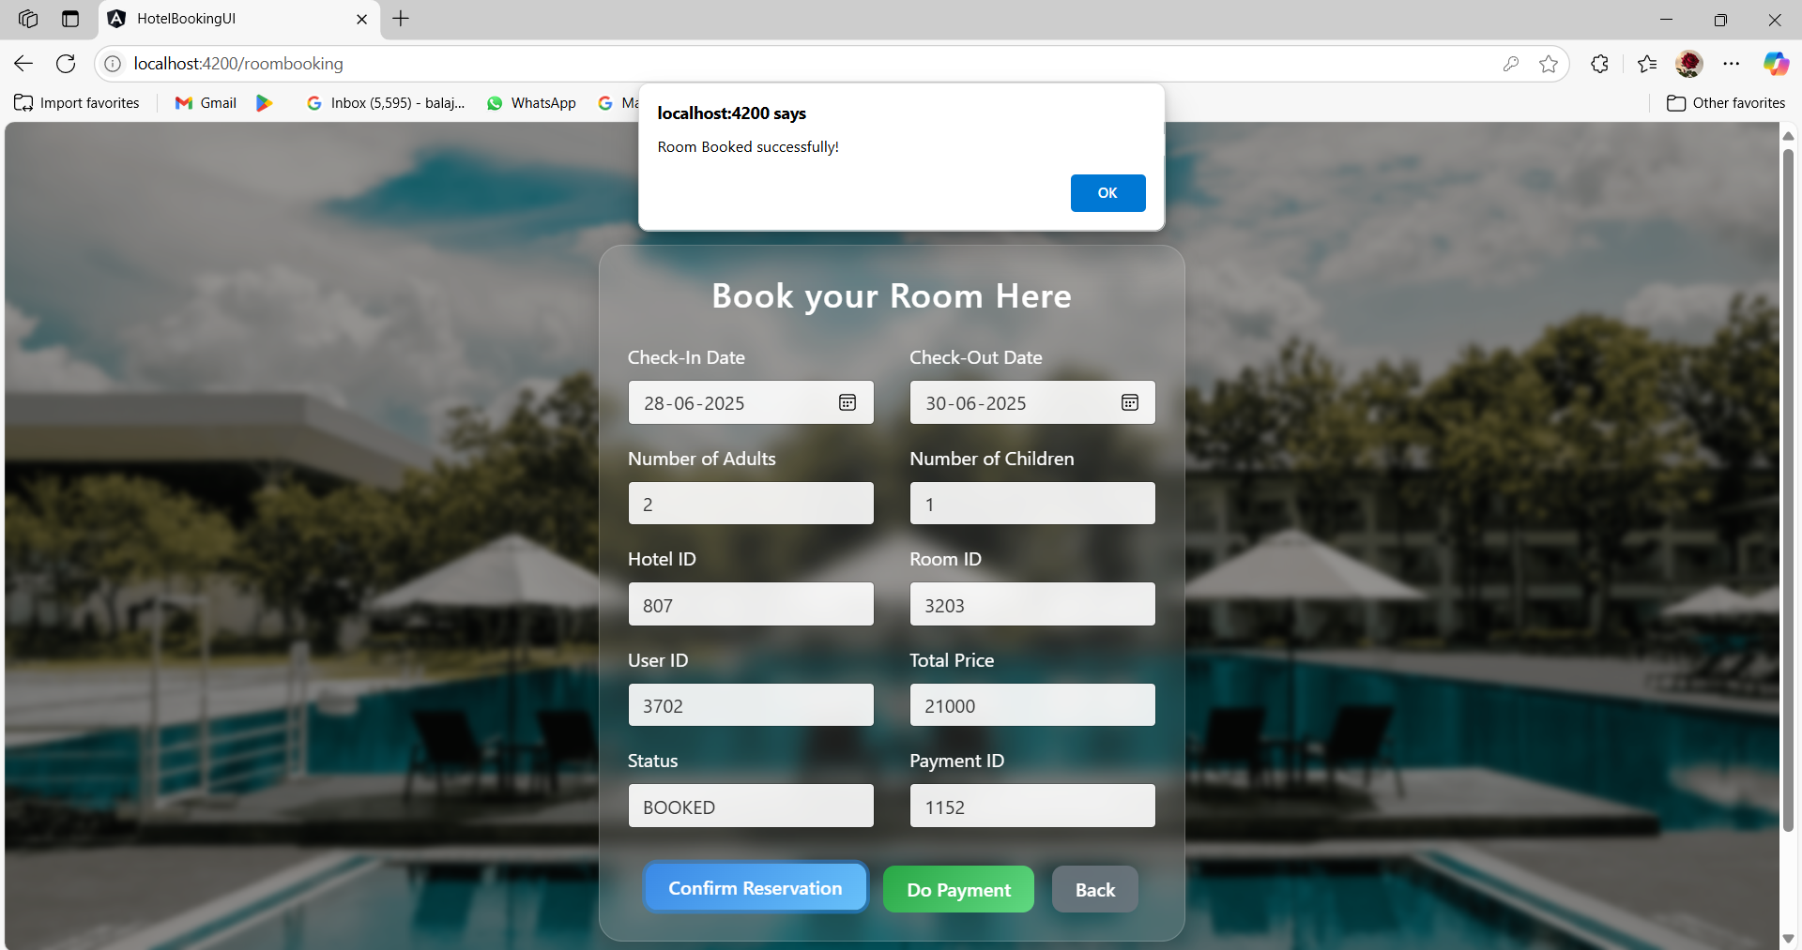

Slide 18
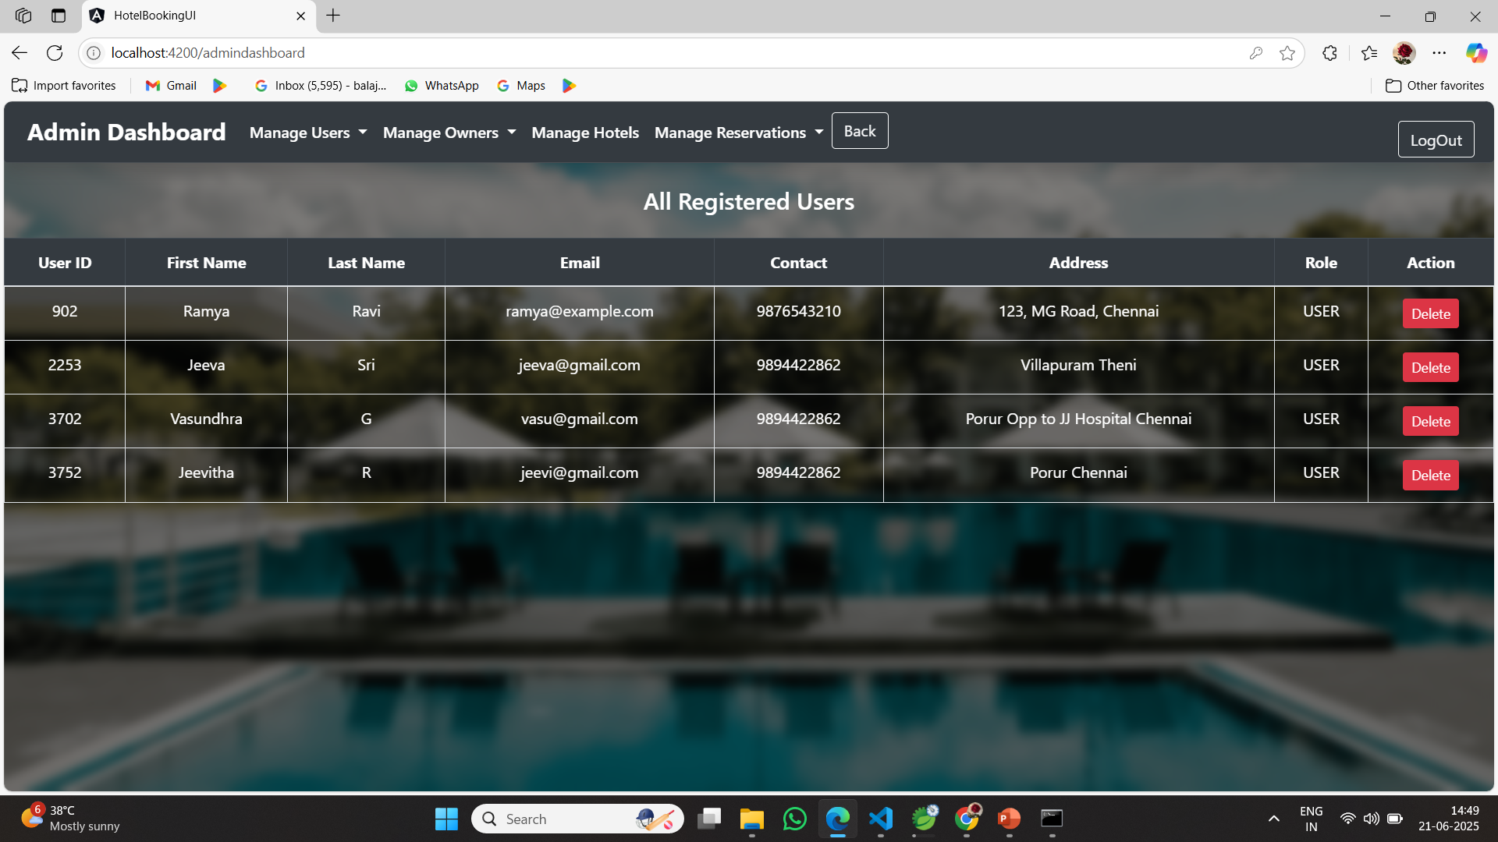

Slide 19
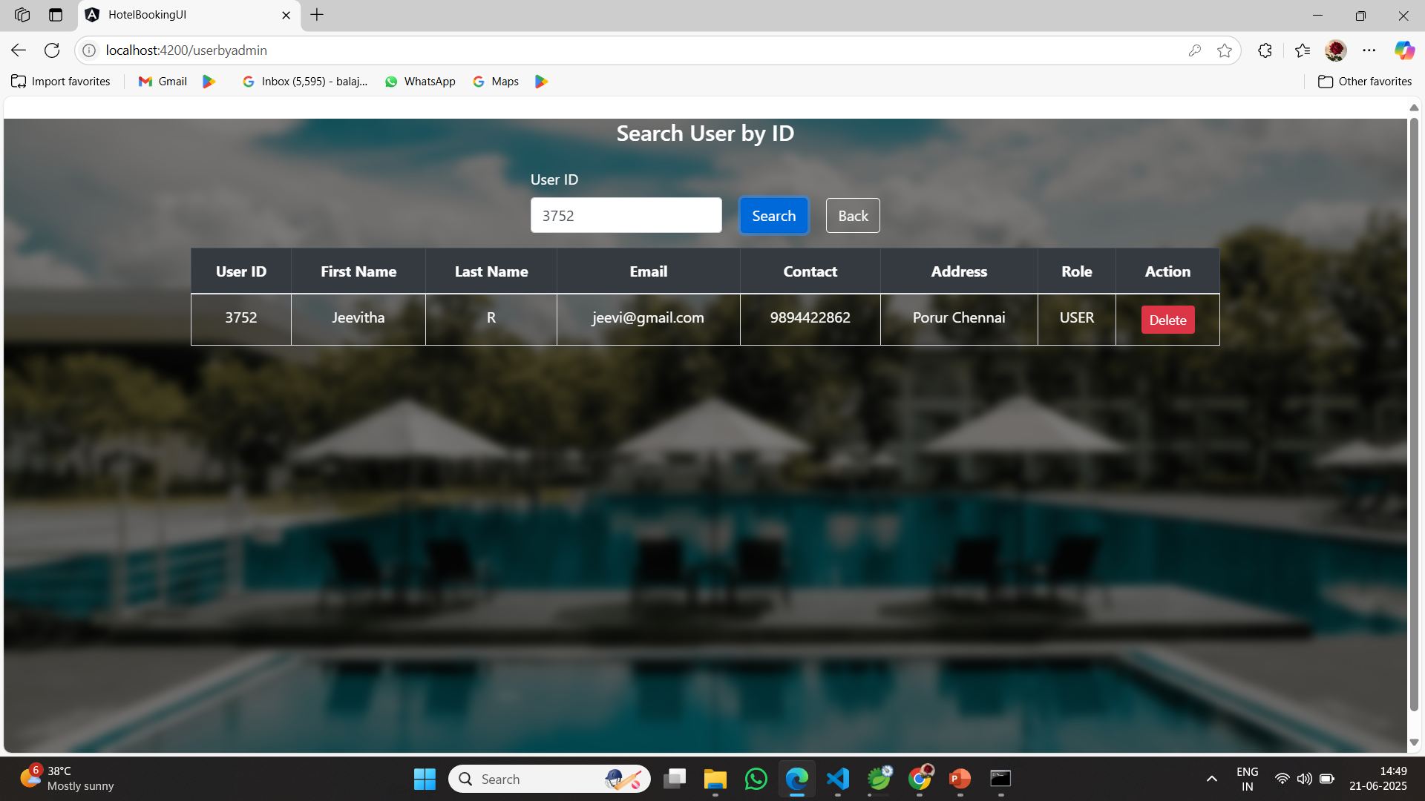

Slide 20
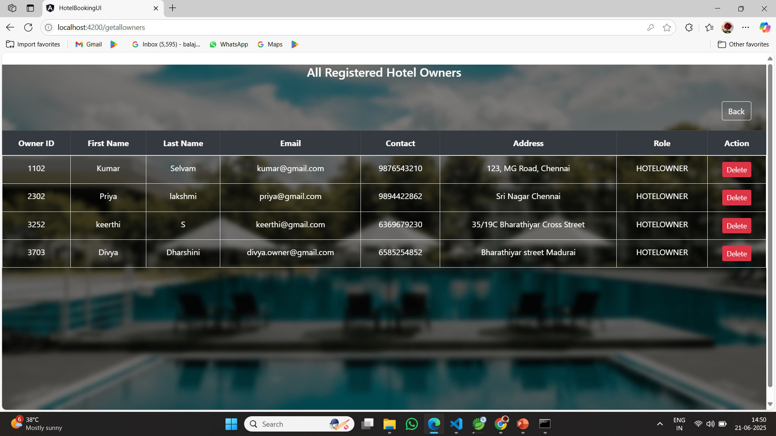

Slide 21
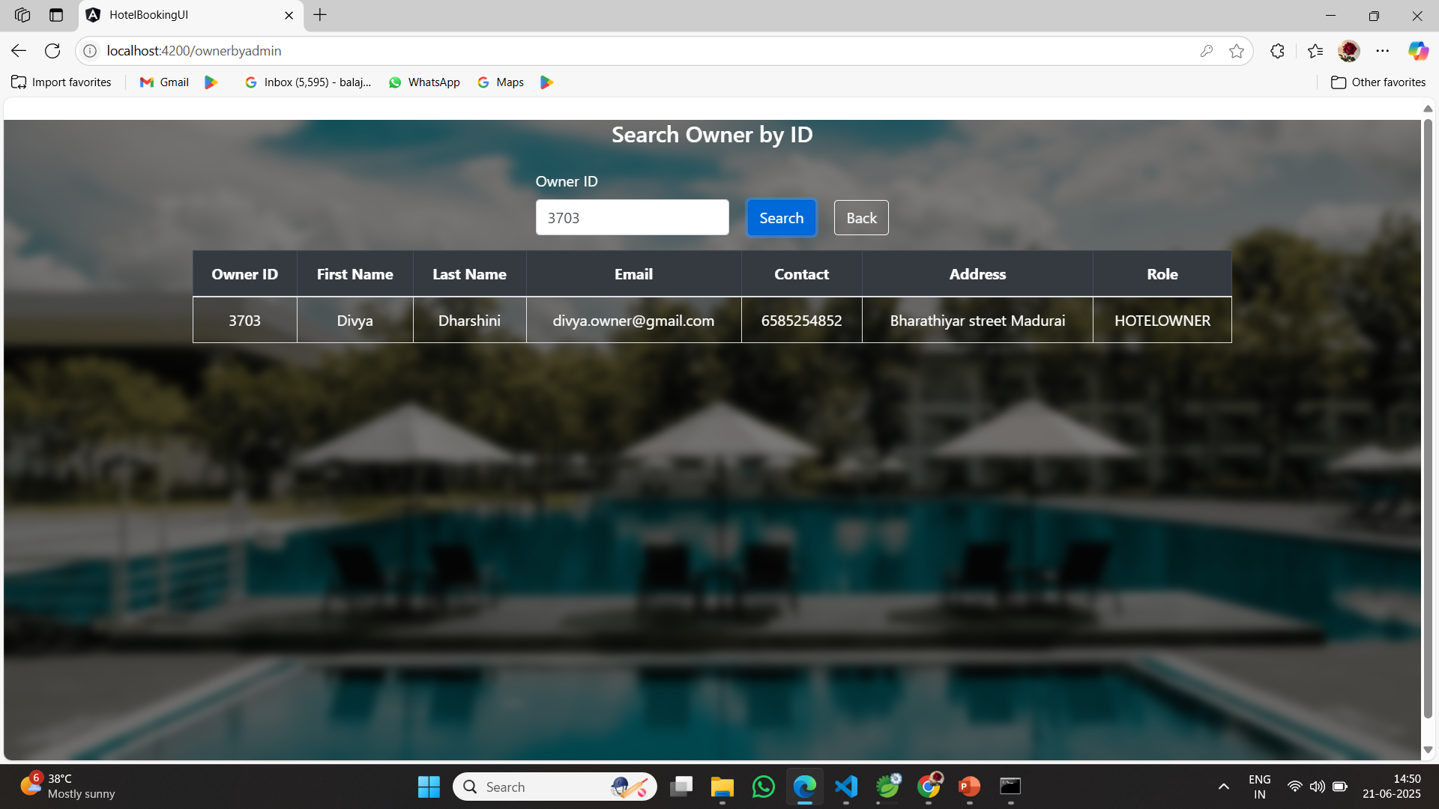

Slide 22
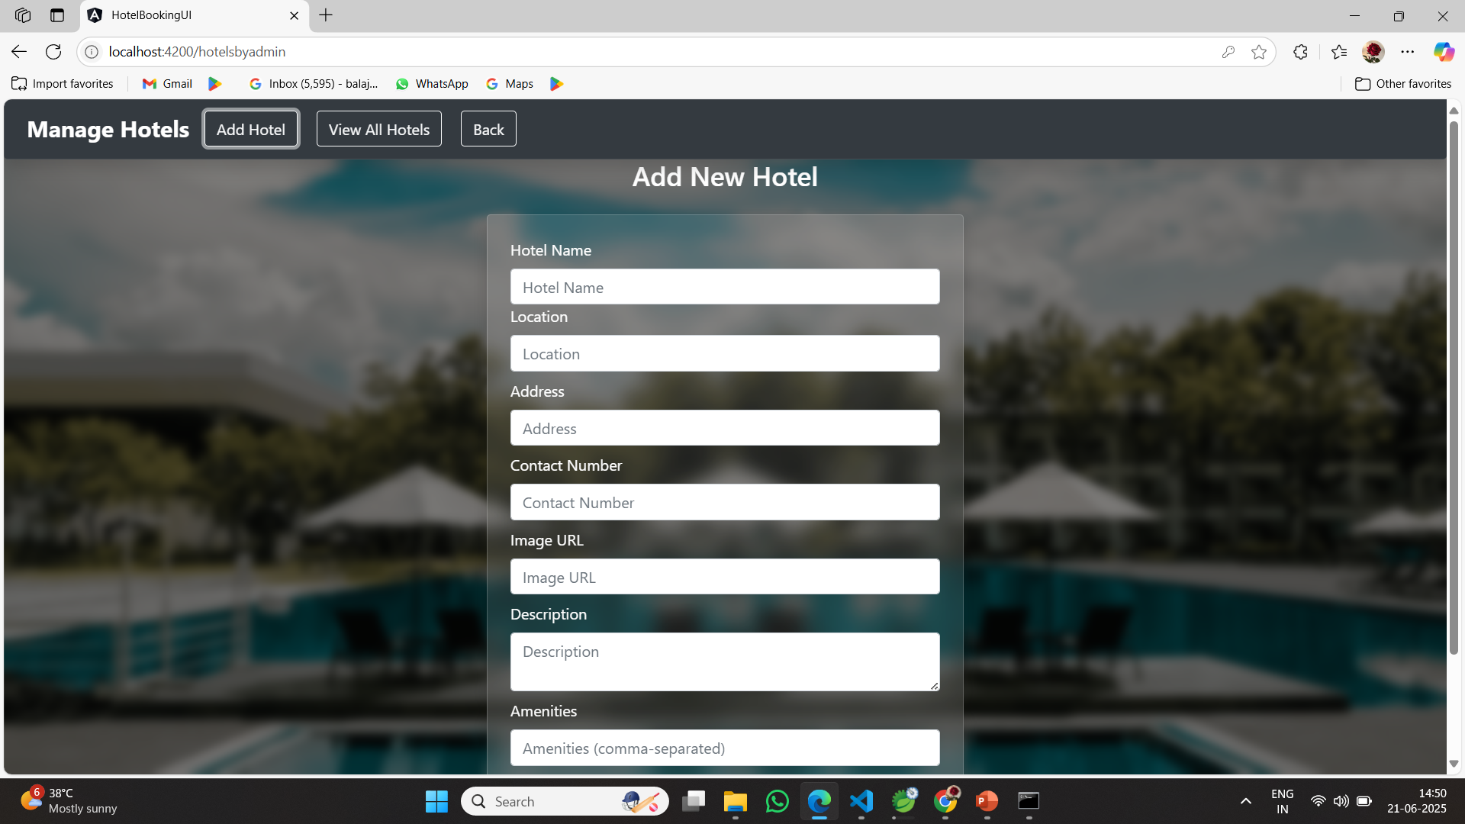

Slide 23
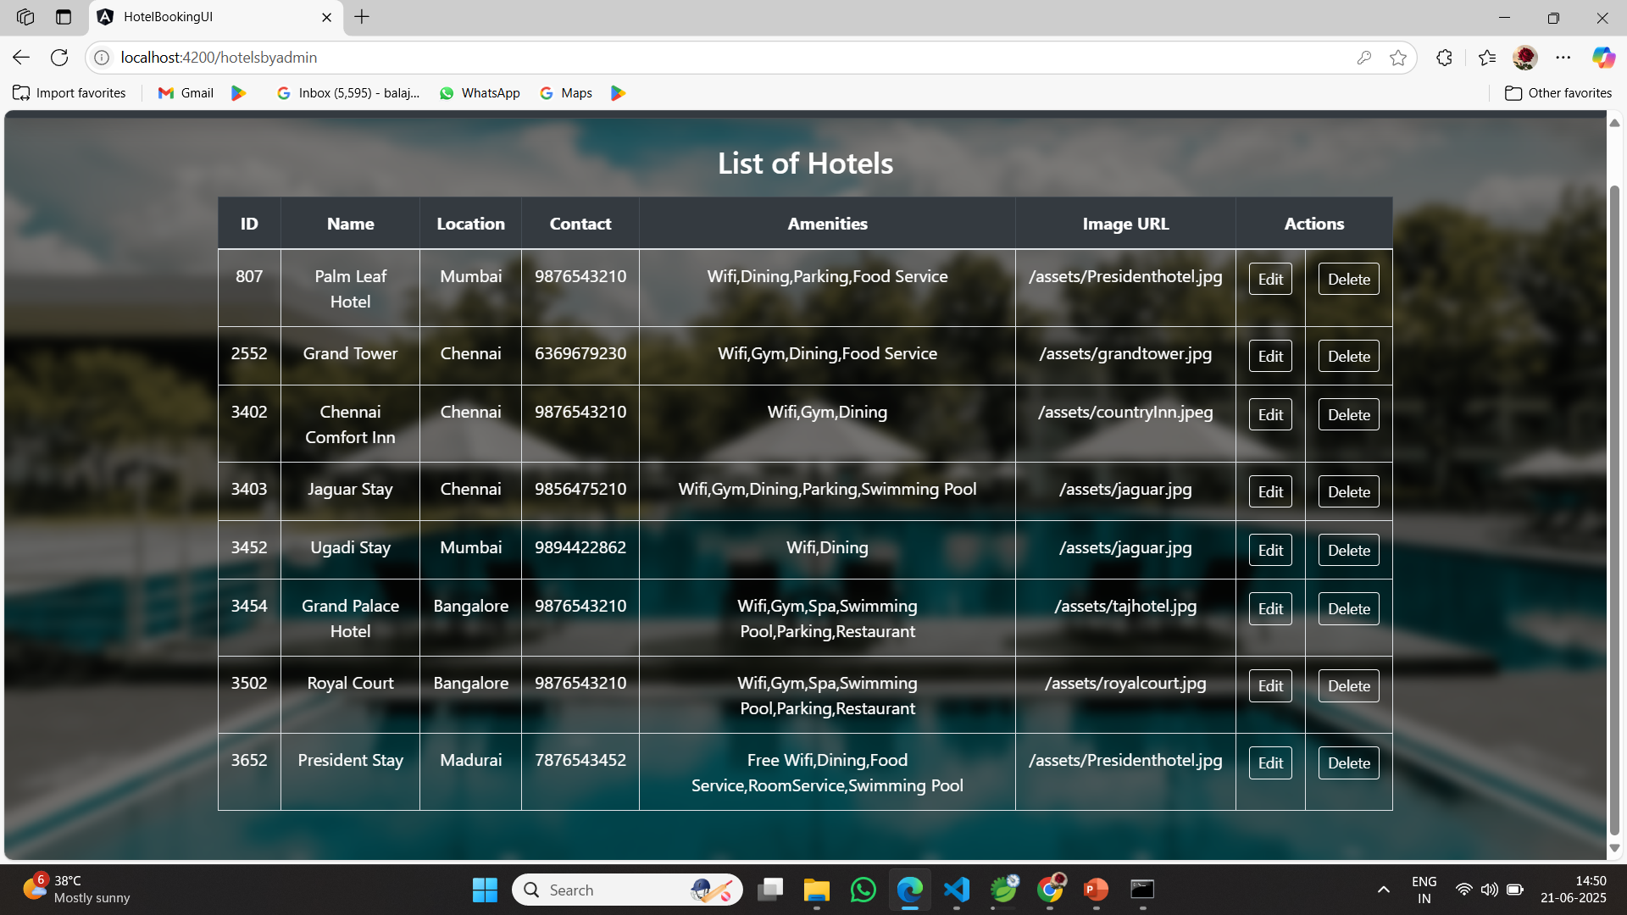

Slide 24
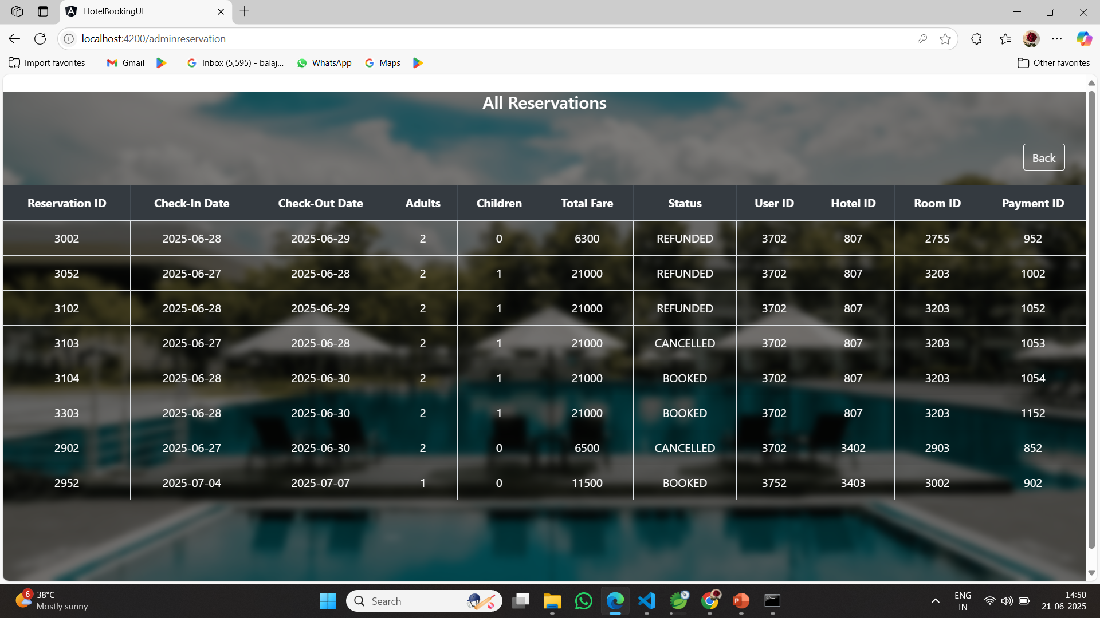

Slide 25
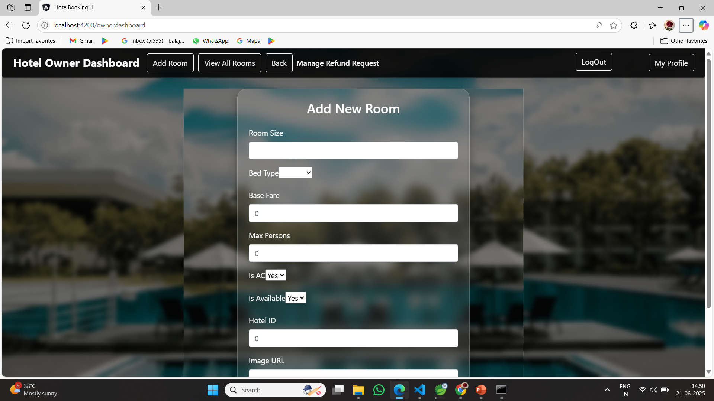

Slide 26
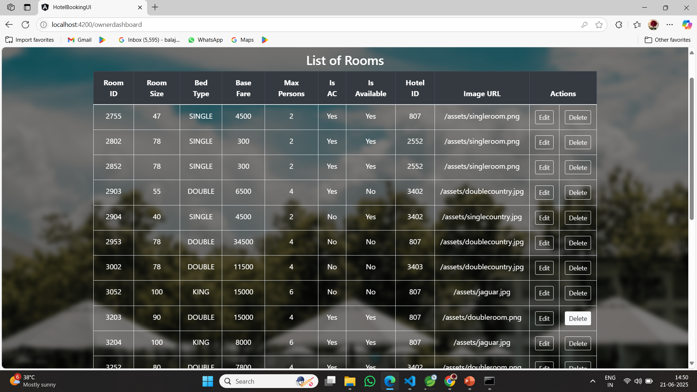

Slide 27
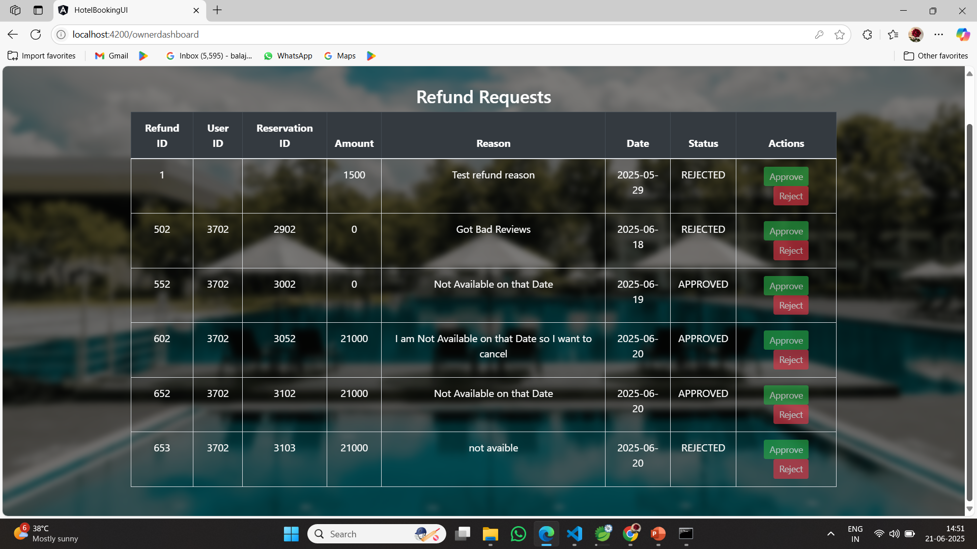

Slide 28
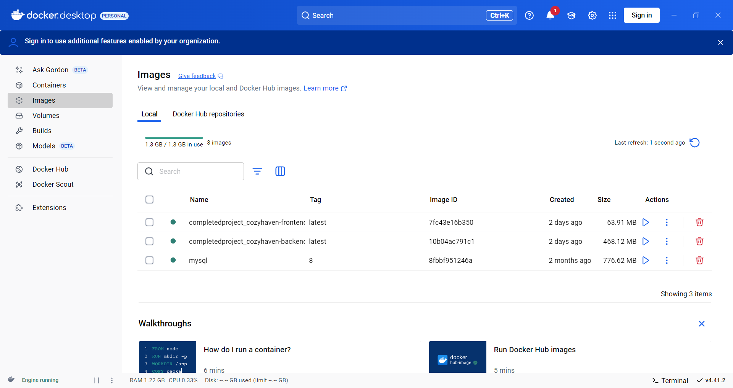

Slide 29
THANK YOU

